Slide 1
Shortest Path Algorithms

Slide 2
Bellman Ford Single Source Shortest Path Algorithm
Bellman Ford is also applicable on a directed and weighted graph
Bellman Ford is also applicable on a graph containing negative weights (unlike Dijkstra)

Slide 3
What does a negative weight edge represents in a graph?

Slide 4
Negative Weight Cycle in a Graph
A negative weight cycle is a cycle with weights that sum to a negative number.
If a graph contains negative weight edges, it does not mean that it contains (-)ve weight cycle also.
But, if a graph contains only positive weight edges, then there can not exits a (-)ve weight cycle.

Slide 5
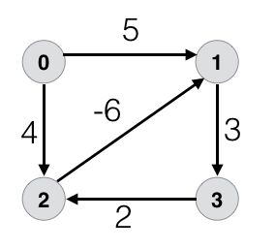
Example (Graph containing Negative Weight Cycle)

Slide 6
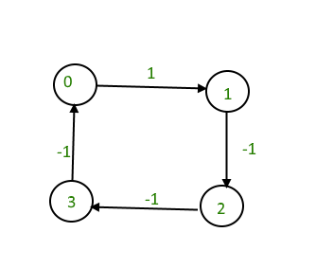
Another Example

Slide 7
Another Single Source Shortest Path Algorithm – Bellman Ford
Bellman Ford Algorithm can also detect the presence of a (-)ve weight cycle in the graph

Slide 8
Algorithm
Input: Graph and a source vertex src
Output: Shortest distance to all vertices from src. If there is a negative weight cycle, then shortest distances are not calculated, negative weight cycle is reported.
1) This step initializes distances from source to all vertices as infinite and distance to source itself as 0. Create an array dist[] of size |V| with all values as infinite except dist[src] where src is source vertex.
2) This step calculates shortest distances. Do following |V|-1 times where |V| is the number of vertices in given graph.
…..a) Do following for each edge u-v
If dist[v] > dist[u] + weight of edge uv, then update dist[v]
dist[v] = dist[u] + weight of edge uv

Slide 9
3) This step reports if there is a negative weight cycle in graph. Do following for each edge u-v
……If dist[v] > dist[u] + weight of edge uv,
then “Graph contains negative weight cycle”
The idea of step 3 is, step 2 guarantees shortest distances if graph doesn’t contain negative weight cycle. If we iterate through all edges one more time and get a shorter path for any vertex, then there is a negative weight cycle

Slide 10
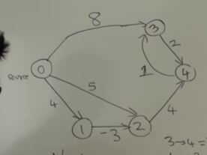
Example to understand Bellman

Slide 11
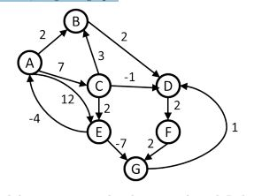
Example to understand Bellman

